Slide 1

Introduction to ARM Cortex-M Processors
CDAC ACTS, Pune

Slide 2
My promise !
I am confident that this course will save you many, many hours of studying/experimenting/googling time to learn about this processor.
I stand behind this course 100% and am committed to helping you .
A Promise that I need from you !
Daily 30Mins of Revision of what is taught in the class

Slide 3
What am I going to get from this course?
Programming Micro-controllers using ‘C'
Learn about embedded software development and debugging using STM Cube IDE
Learn about Mixed ‘C’ and Assembly Coding
Demystifying Memory, Bus interfaces, NVIC, Exception handling with lots of animation
Low level register Programming for interrupts, System Exceptions, Setting Priorities, Preemption etc.
Learn writing IRQ handlers , IRQ numbers, NVIC and many more
Learn about OS related features like SVC, SysTick, PendSv and many more

Slide 4
Cortex M3 @ S/W Developer point of View
Programming Model
How exceptions are handled
The Memory Map
Peripheral Interfacing
How to use software driver libraries from Microcontroller Vendor.
CMSIS Core API’s
STM32CUBE Libraries

Slide 5
Agenda
What are the ARM Cortex M Processors?
The CortexM3 and M4 Processors
The Cortex-M Processor Family
Advantage of the Cortex-M Processors
Low Power
Performance
Energy Efficiency
Code Density
Interrupts
Ease of use, C friendly
Scalability
Application of the ARM Cortex-M Processor
Background and History
ARM processor evolution
Architecture versions and Thumb ISA

Slide 6

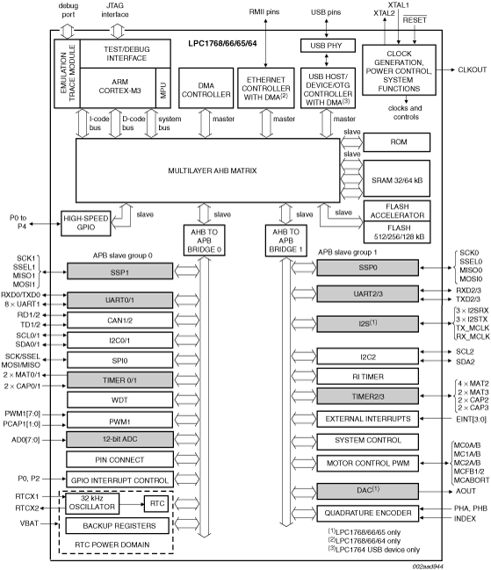
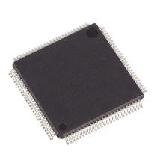

What’s Happening in Microcontrollers?
Microcontrollers are getting cheap
  32-bit ARM Cortex-M3 Microcontrollers @ INR 1200
  Some microcontrollers sell for as little as INR 400
Microcontrollers are getting powerful
  Lots of processing, memory, I/O in one package
  Floating-point is even available in some!
Microcontrollers are getting interactive
  Internet connectivity, new sensors and actuators
  LCD and display controllers are common
Creates new opportunities for microcontrollers

Slide 7
What are ARM Cortex M processors?
The Cortex-M3 and Cortex-M4 are processors designed by ARM. The Cortex-M3 processor was the first of the Cortex generation of processors, released by ARM in 2005 (silicon products released in 2006). The Cortex-M4 processor was released in 2010 (released products also in 2010).
The Cortex-M3 and Cortex-M4 processors use a 32-bit architecture.
Internal registers in the register bank, the data path, and the bus interfaces are all 32 bits wide. The Instruction Set Architecture (ISA) in the Cortex-M processors is called the Thumb ISA and is based on Thumb-2 Technology which supports a mixture of 16-bit and 32-bit instructions.

Slide 8
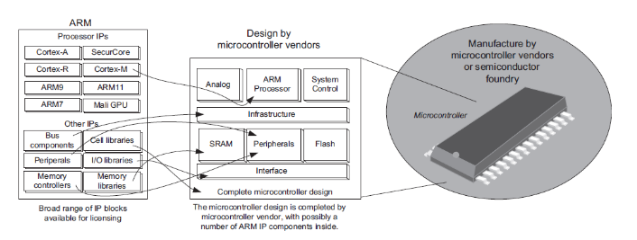
Microcontroller Containing ARM IP Products

Slide 9
ARM Cortex-M3 Microcontroller
▪
▪
▪
▪
▪
▪
18 x 32-bit registers Excellent compiler target
Reduced pin count requirements Efficient interrupt handling Power management
Efficient debug and development support features
Breakpoints, Watchpoints,
Flash Patch support,
Instruction Trace Strong OS support
User/Supervisor model
OS support features
Designed to be fully programmed in C (even reset, interrupts and exceptions)
▪
▪

Slide 10
ARM Cortex-M3 Microcontroller
▪
▪
▪
▪
▪
▪
▪
▪
▪
▪
▪
▪
▪
ARMv7M Architecture No Cache - No MMU
Debug is optimized for microcontroller applications Vector table contains addresses, not instructions
DIV instruction
Interrupts automatically save/restore state
Exceptions programmed in C (No Coprocessor 15 - All registers are memory-mapped) Interrupt controller is part of Cortex-M3 macrocell
Fixed memory map Bit-banding
Non-Maskable Interrupt (NMI) Only one processor status reg Thumb-2 processing core
▪
▪
Mix of 16 and 32 bit instructions for very high code density Gives complete Thumb compatibility

Slide 11
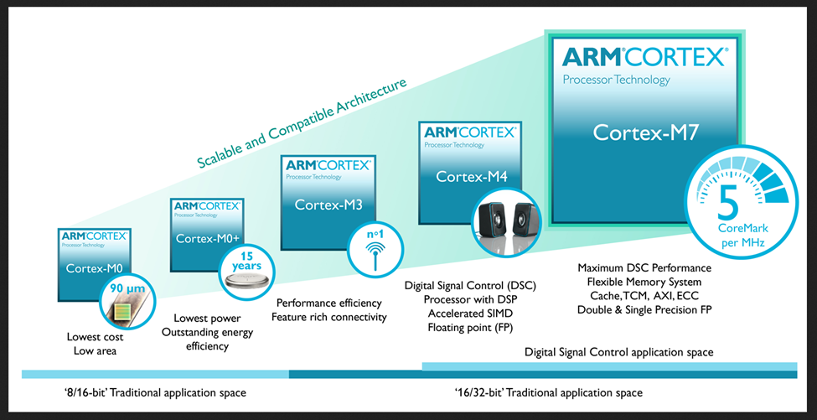
The Cortex M Processor Family

Slide 12
Advantage of Cortex –M Processor
Low Power
Currently, many Cortex-M microcontrollers have power consumption of less than 200 uA/MHz, with some of them well under 100 uA/MHz. In addition, the Cortex-M processors also include support for sleep mode features and can be used with various advanced ultra-low power design technologies.
Performance
The Cortex-M3 and Cortex-M4 processors can deliver over 3 CoreMark/MHz & 1.25 DMIPS
Energy Efficiency
Code Density
Interrupts
Ease of use, C friendly

Slide 13
Features Cont.
Scalability
Debug Friendly
OS Support
Versatile system features
    Bit Banding
    MPU
Software portability and reusability
    CMSIS
Application of Cortex M Processors
Microcontrollers
Automotive
Industrial Control
Consumer Products
DSP

Slide 14
Architecture Version and Thumb ISA
The successful ARM7TDMI is based on the architecture version ARMv4T (The “T” means Thumb instruction support).
Note that architecture version numbers are independent of processor names.
The Architecture version 7 is divided into three profiles
  Cortex-A Processors: ARMv7-A Architecture
  Cortex-R Processors: ARMv7-R Architecture
  Cortex-M Processors: ARMv7-M & ARMv6-M Architectures

Slide 15
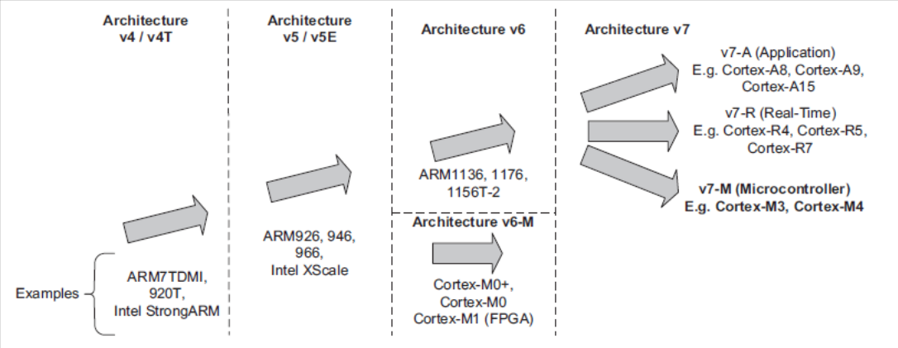
ISA Enhancement and Evolution

Slide 16
Introduction to Embedded Software Development
CDAC ACTS, Pune

Slide 17
Agenda
What are inside typical ARM microcontrollers?
What you need to start
Development Suites
Development Boards
Debug Adaptor
Documentation and other resources
Software Development Flow
Compiling your Application
Software flow
Polling
Interrupt Driven
Multi Tasking System
Input, output and peripherals accesses
Microcontroller interfaces
Cortex Microcontroller software interface standard (CMSIS)

Slide 18
What are inside typical ARM µC.
In many microcontrollers, the processor takes less than 10% of the silicon area, and the rest of the silicon die is occupied by other components such as:
Program memory (e.g., flash memory)
SRAM
Peripherals
Internal bus infrastructure
Clock generator (including Phase Locked Loop), reset generator, and distribution network for these signals
Voltage regulator and power control circuits
Other analog components (e.g., ADC, DAC, voltage reference circuits)
I/O pads

Slide 19
What you need to start
Development suites
  µVision Keil (DESD)
  STM32CubeIDE (e-DESD)
Development Board
  Blue board (DESD)
  STM32F4 Discovery Board (e-DESD)
Debug Adaptor
  OM13088 (JTAG debugger) LPC Expresso 4367 (DESD)
  STLinkv2 (e-DESD)
Documents and other Resources
  Link to Resources

Slide 20
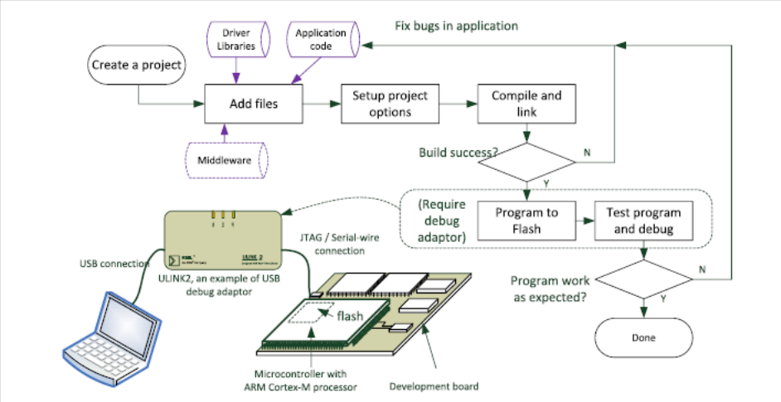
Software Development Flow

Slide 21
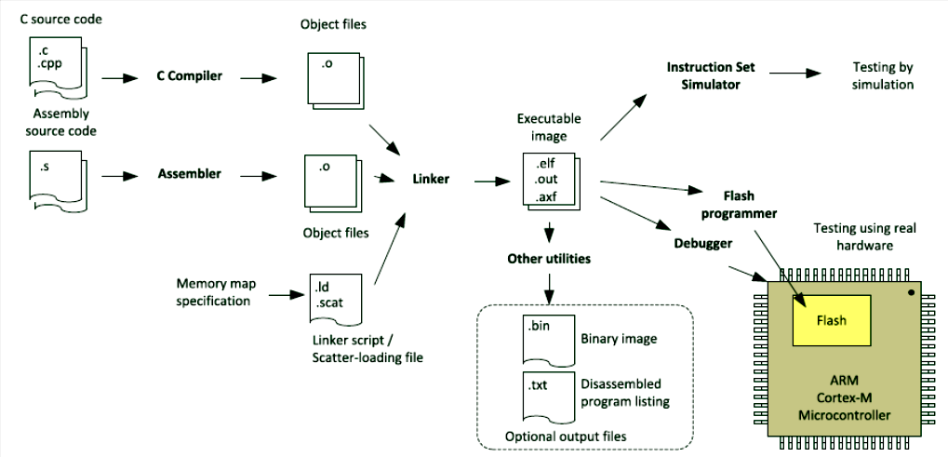
Software Compiling Flow

Slide 22
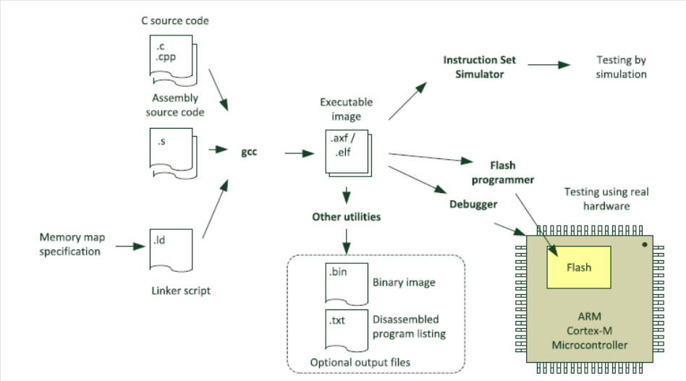
Compilation flow for GNU toolchain

Slide 23
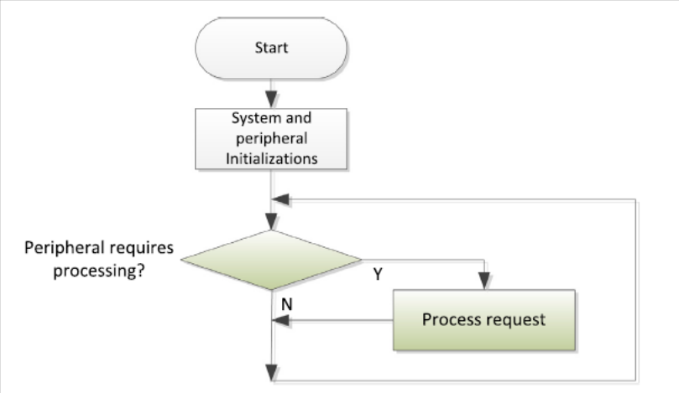
Polling Flow

Slide 24
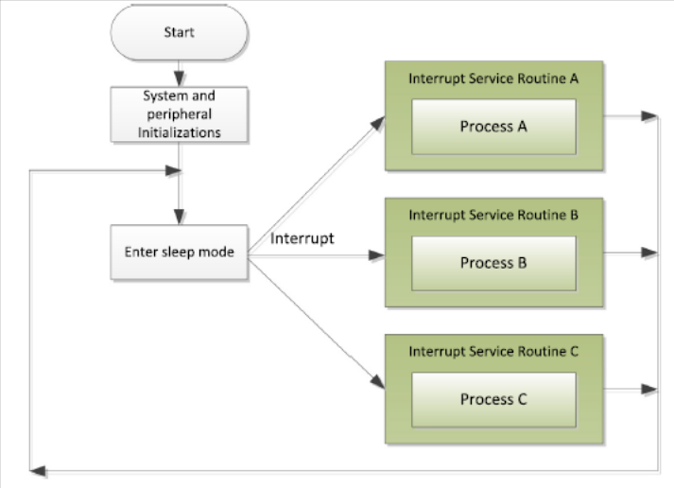
Interrupt Driven

Slide 25
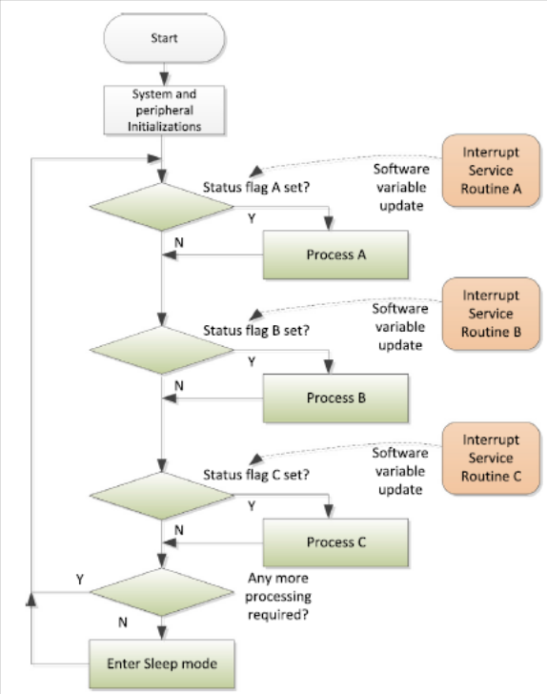
Multi Tasking System
In these applications, a Real-Time Operating System(RTOS) can be used to handle the task scheduling.
An RTOS allows multiple processes to be executed
concurrently, by dividing the processor’s time into time slots and allocating the time
slots to the processes that require services.

Slide 26
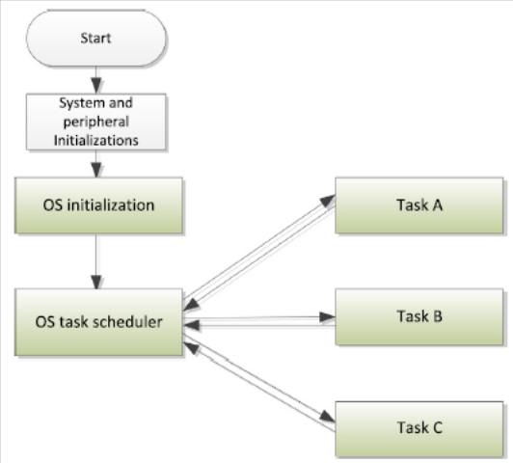
RTOS to Handle Multiple Task

Slide 27
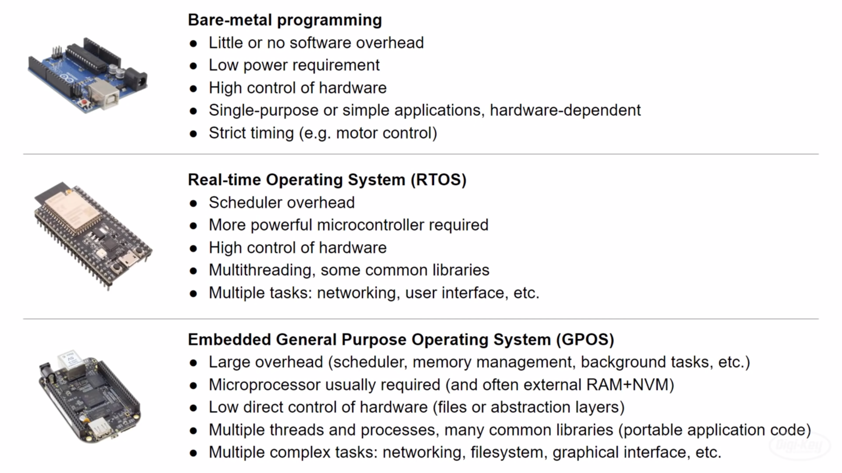
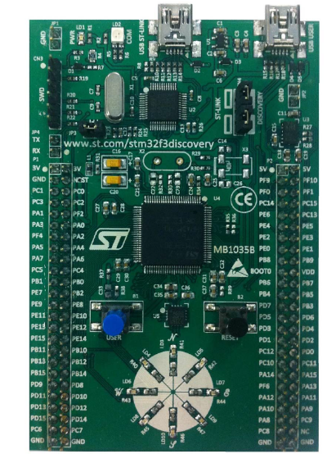
Bare-metal vs RTOS vs GPOS

Slide 28
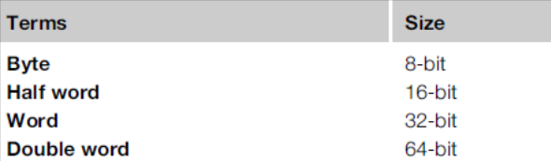
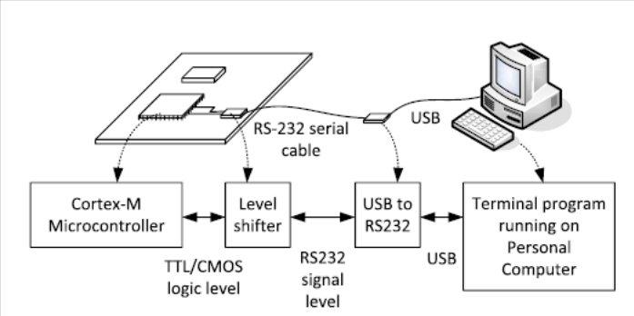
ARM Data Size Definition & Interfaces

Slide 29
Technical Overview
CDAC ACTS, Pune

Slide 30
Agenda
General information about Cortex M3 and M4 processors?
Processor type and Architecture
Instruction Set
Block Diagram
Memory system
Interrupt and exception support
Features of Cortex M3 and Cortex M4 Processor
Performance
Code Density
Low Power
Memory System and Protection Unit
Interrupt Handling
OS support
Debug Support
Scalability and Compatibility

Slide 31
Processor type and Architecture
All the ARM Cortex-M processors are 32-bit RISC (Reduced Instruction Set Computing) processors. They have:
32-bit registers
32-bit internal data path
32-bit bus interface
3 Stage Pipelining (FDE)
Harvard Bus Arch.(Simul. Instrn. Fetch & Data Access)
32-bit Addressing which allow 4GB address space
Load and Store Arch.
Processor Arch. ARMv7M

Slide 32
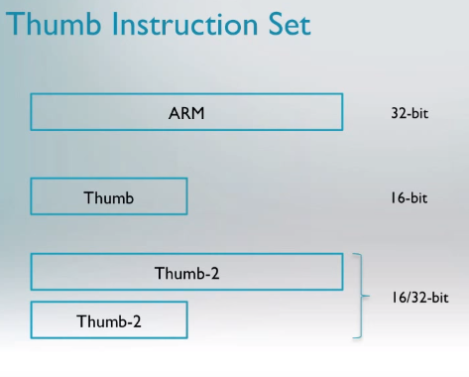

Instruction Set - Thumb2
High Performance
High Performance & High Code Density

Slide 33



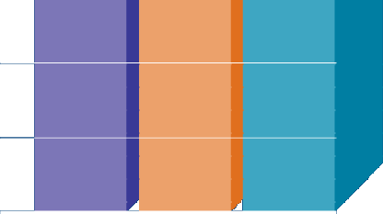





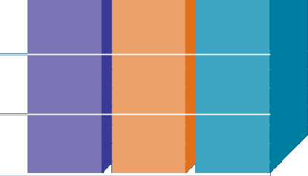


The Thumb-2 instruction set
▪
Variable-length instructions
ARM instructions are a fixed length of 32 bits
Thumb instructions are a fixed length of 16 bits
Thumb-2 instructions can be either 16-bit or 32-bit
Thumb-2 gives approximately 26% improvement in code density over ARM
Thumb-2 gives approximately 25% improvement in performance over Thumb

Slide 34
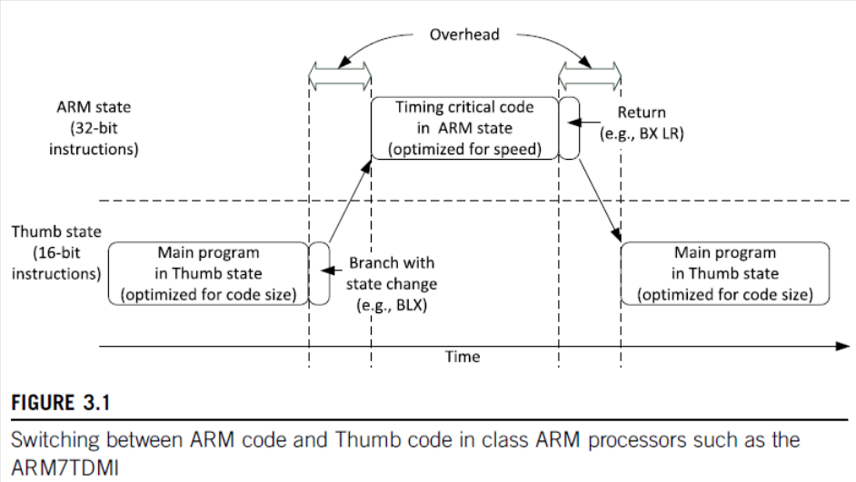
ARM and Thumb Mode Switching

Slide 35
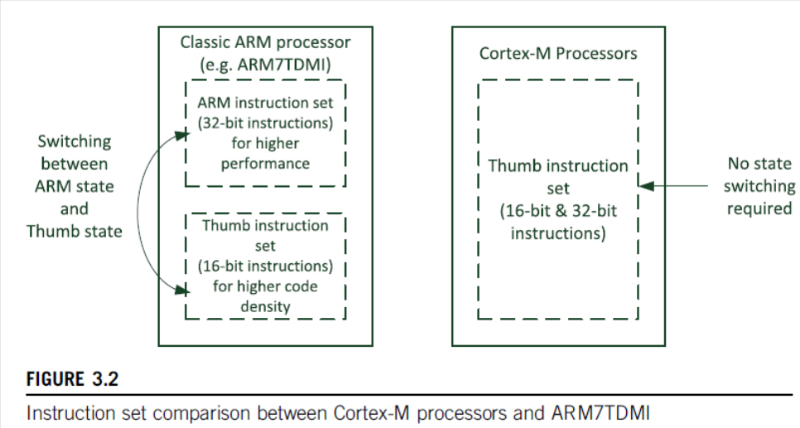
Thumb2 No Switching Req.

Slide 36
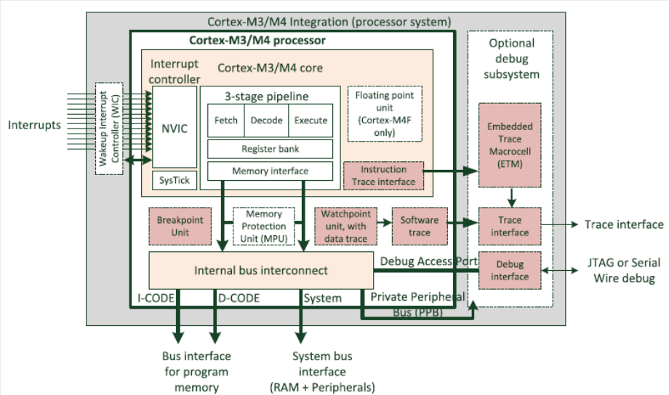
Block Diagram

Slide 37
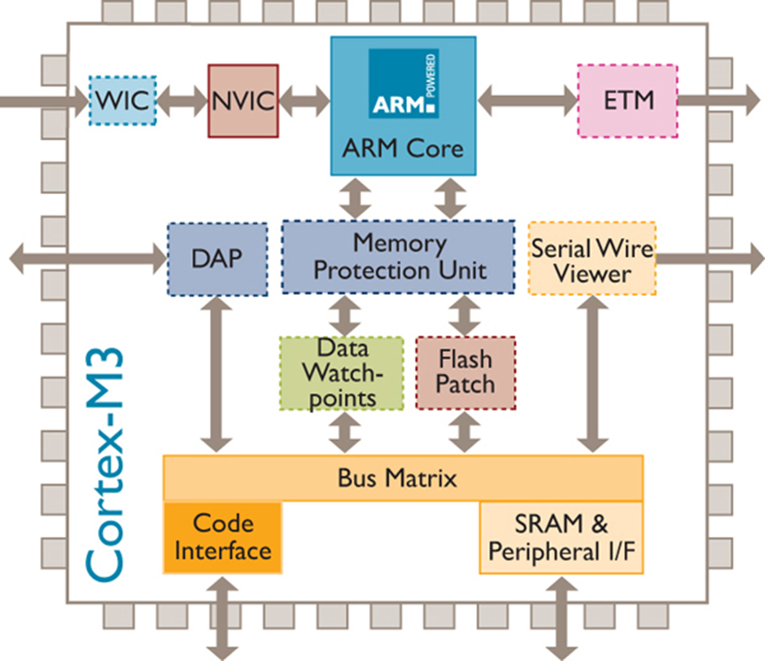
Cortex M3 Internals

Slide 38
ARM Cortex-M3 Processor
ETM
Instruction Trace
NVIC
1-240 Interrupts
8-256 Priorities
ARM
Cortex-M3 Core
(5-pins)
Trace Port
Serial-Wire Viewer
(1-pin)
I
D
TPIU
Trace Port
DAP
JTAG/SWD
MPU
ITM
Instrumentation Trace
DWT
Data Trace
FPB
BKPT
Bus Matrix
Code Buses
to Flash
to Code SRAM
System Bus to Stack SRAM to Peripherals

Slide 39
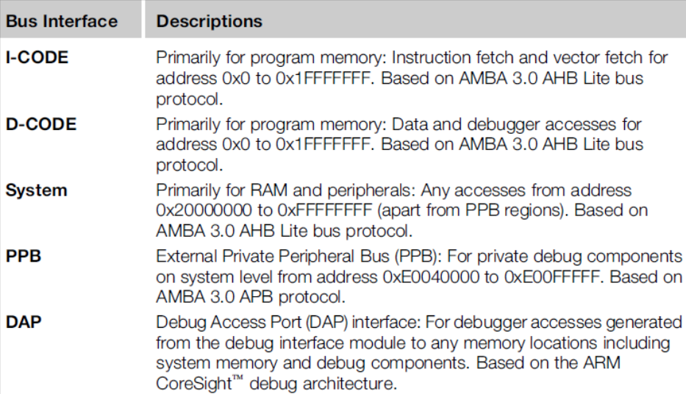
Various Bus Interfaces on Cortex M3

Slide 40
AMBA System
High Performance ARM processor
APB
UART
High Bandwidth External Memory Interface
Timer
AHB
APB
Bridge
Keypad
High-bandwidth on-chip RAM
DMA
Bus Master
PIO
Low Power
Non-pipelined Simple Interface
High Performance Pipelined
Burst Support Multiple Bus Masters

Slide 41
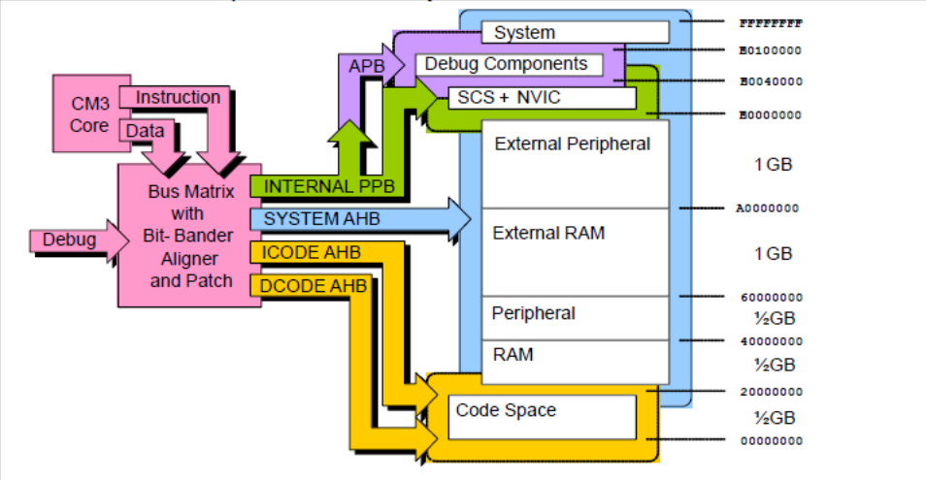
Memory Map
Very simple linear 4GB memory map
The Bus Matrix partitions memory access via the AHB and PPB buses

Slide 42
Memory System & Interrupt support
Typically, the microcontroller vendor will need to add the following items to the memory system:
Program memory, typically flash
Data memory, typically SRAM
Peripherals
The Cortex-M3 and Cortex-M4 processors include an interrupt controller called the Nested Vectored Interrupt Controller (NVIC).
It is programmable and its registers are memory mapped.
The address location of the NVIC is fixed and the programmer’s model of the NVIC is consistent across all Cortex-M processors.
NVIC supports a number of system exceptions, including a Non-Maskable Interrupt (NMI).

Slide 43
Features of Cortex M3 - Performance
  The three-stage pipeline allows most instructions, including multiply, to execute in a single cycle, and at the same time allows high clock frequencies for microcontroller devices e typically over 100 MHz, and up to approx. 200 MHz in modern semiconductor manufacturing processes.
  Multiple bus interfaces allow simultaneous instruction and data accesses to be performed.
  The pipelined bus interface allows a higher clock frequency in the memory system.
  The highly efficient instruction set allows complex operations to be carried out in a low numbers of instructions.
  Each instruction fetch is 32-bit, and most instructions are 16-bit. Therefore up to two instructions can be fetched at a time

Slide 44
Code Density
• Thumb-2 technology allows 16-bit instructions and 32-bit instructions to work together without any state switching overhead. Most simple operations can be carried out with a 16-bit instruction.
Various memory addressing modes for efficient data accesses
Multiple memory accesses can be carried out in a single instruction
Support for hardware divide instructions and Multiply-and-Accumulate (MAC) instructions exist in both Cortex-M3 and Cortex-M4
Instructions for bit field processing in Cortex-M3/M4
Single Instruction, multiple data (SIMD) instruction support exists in Cortex-M4
Optional single precision floating point instructions are available in Cortex

Slide 45
Low Power
The Cortex-M processors provide a number of low power features. These include
  Multiple sleep modes defined in the architecture
  Integrated architectural clock gating support, which allows clock circuits for parts of the processor to be deactivated when the section is not in use.
The processors also have additional optional hardware support:
  Wakeup Interrupt Controller (WIC) to enable advanced low power technologies such as State Retention Power Gating (SRPG).

Slide 46
Memory System and Endianness
Optional bit band feature: two bit addressable regions in SRAM and peripheral regions. Bit value modifications via bit band alias addresses are converted into
atomic Read-Modify-Write operations to bit band regions.
Exclusive accesses for multi-processor system designs. This is important for semaphore operation in multi-processor systems.
Support of little endian or big endian memory systems. The Cortex-M3/M4 processors can operate in both little endian or big endian mode.

Slide 47
Memory Protection Unit
If an MPU is included, applications can divide the memory space into a number of regions and define the access permissions for each of them.
When an access rule is violated, a fault exception is generated and the fault exception handler will be able to analyze the problem and, if possible, correct it.

Slide 48
Interrupt Handling
Supports up to 240 interrupt inputs, a Non-Maskable Interrupt (NMI) input, and a number of system exceptions.
Each interrupt (except NMI) can be individually enabled or disabled.
Programmable priority levels for interrupts.
The priority levels can be changed dynamically at run time
Automatic handling of interrupt/exception prioritization and nested interrupt/exception handling.
Vector table can be relocated to various areas in the memory.
Low interrupt latency with zero wait state memory system, the interrupt latency is only 12 cycles.

Slide 49
OS Support and system level features
They have a built-in system tick timer called SysTick, which can be set up to generate regular timer interrupts for OS timekeeping.
The Cortex-M3 processors also have banked stacked pointers:
  for OS kernel and interrupts, the Main Stack Pointer (MSP) is used;
  for application tasks, the Process Stack Pointer (PSP) is used.
For simple applications without an OS, the MSP can be used all the time.
To improve system reliability further, the Cortex-M3 and Cortex-M4 processors support the separation of privileged and non-privileged operation modes.

Slide 50
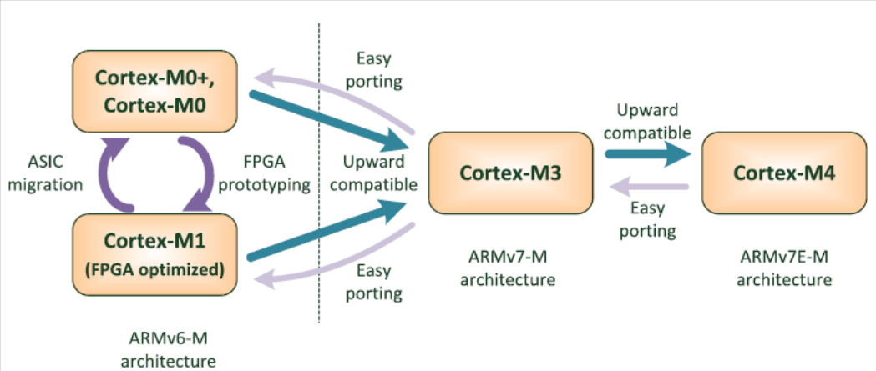
Cortex-M Compatibility

Slide 51
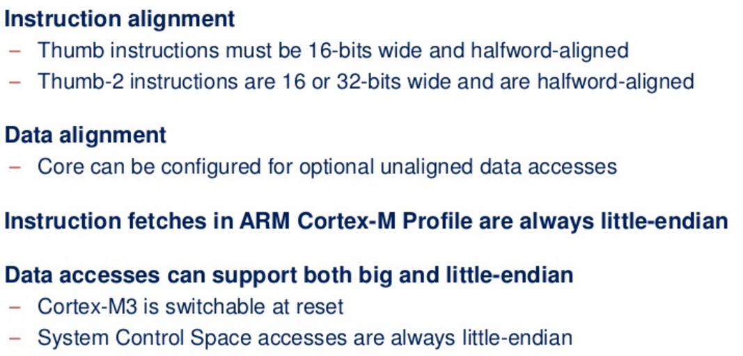
Instruction and Data Alignment

Slide 52
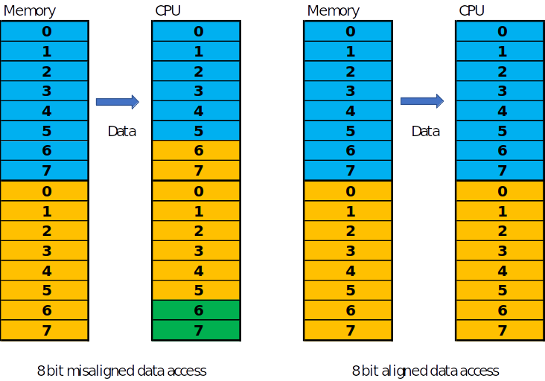
Example of 8 bit Data Alignment

Slide 53
STM32F4x Block Diagram

Slide 54
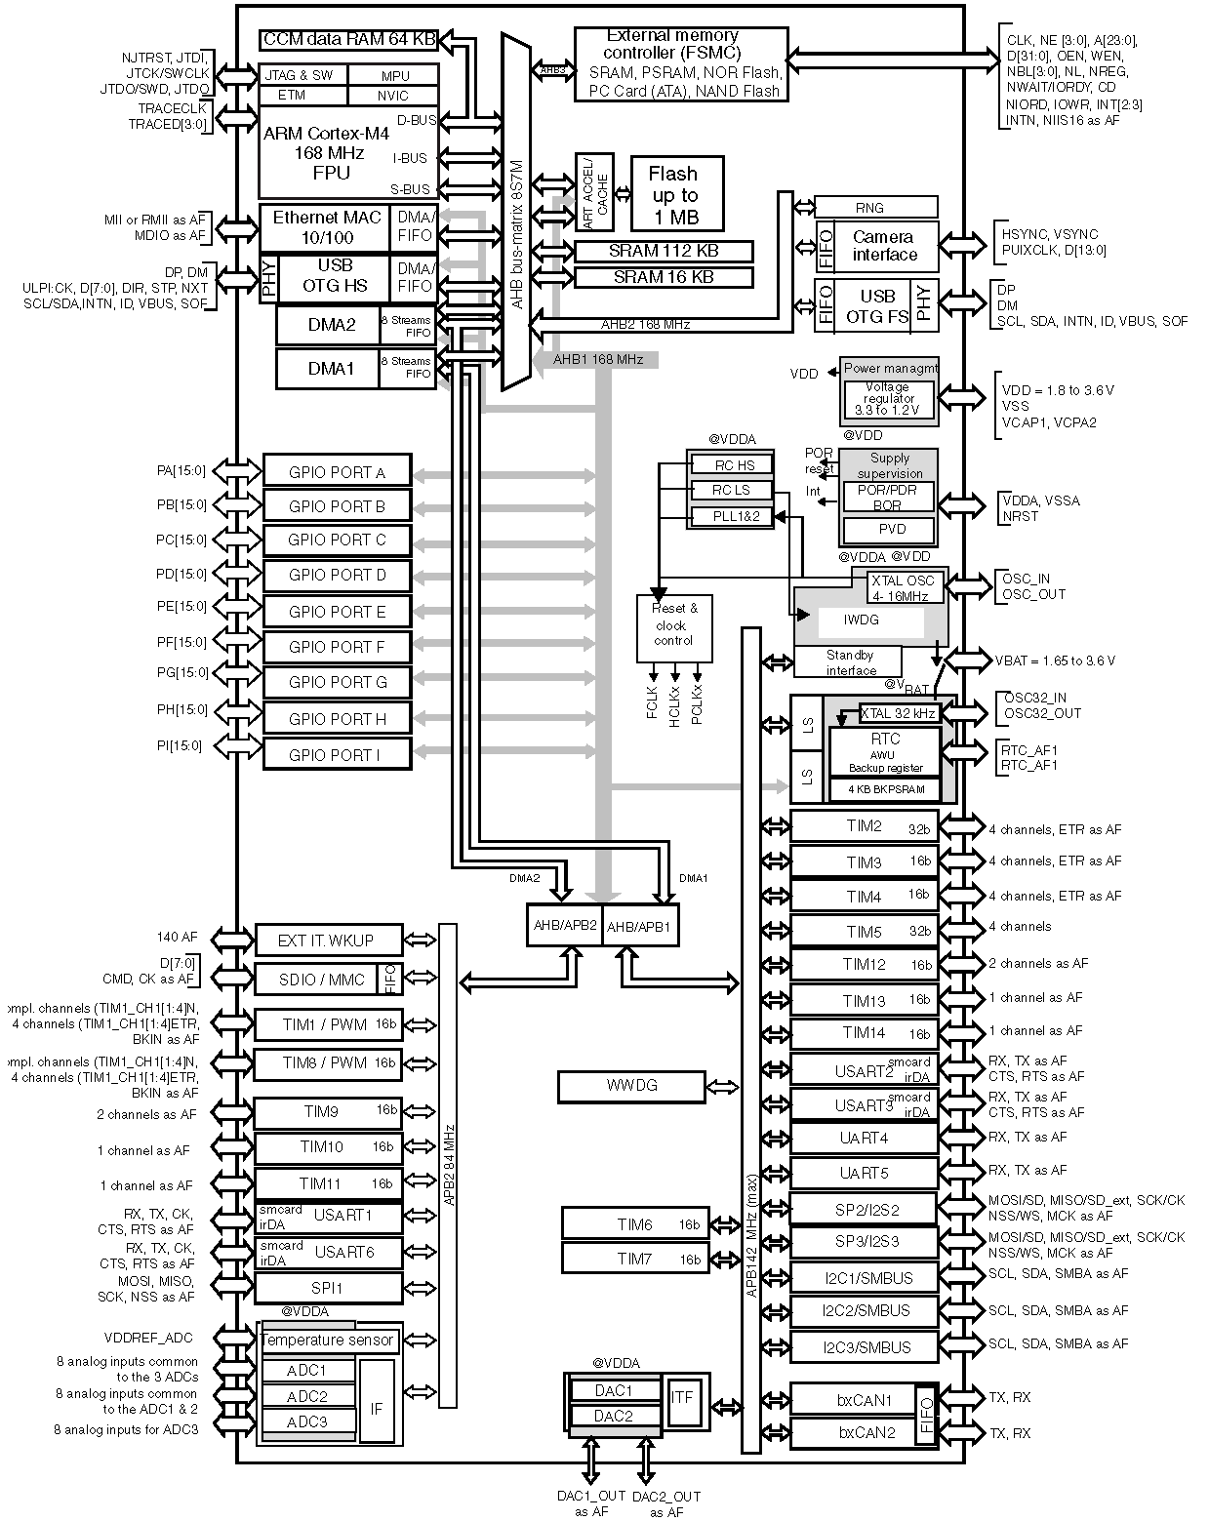

Slide 55
Architecture
CDAC ACTS, Pune

Slide 56
Agenda
Introduction to the Architecture
Programmers Model
Operating Modes and States
Registers
Special registers
Behavior of Application program Status Register(APSR)
Integer status Flags
Q status flag
GE bits
Memory System
Memory system features and Memory Map
Stack Memory & MPU
Exception and Interrupt
What are exceptions?
Nested vector interrupt controller (NVIC)
Vector Table and Fault Handling
System Control Block
Debug and Reset Sequence

Slide 57
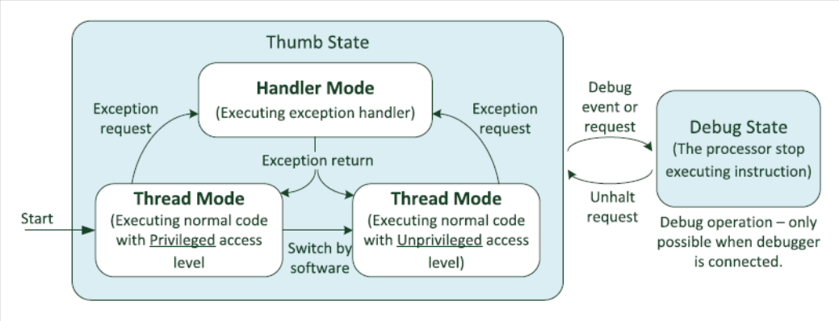
Programmer’s Model
Operation states and Modes

Slide 58
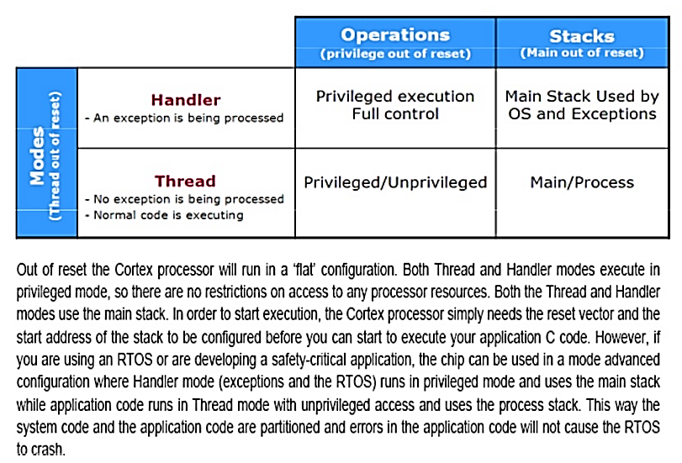
CPU Operating Modes – Cont.
Operation modes
• Handler mode: When executing an exception handler such as an Interrupt Service
Routine (ISR). When in handler mode, the processor always has privileged
access level.
• Thread mode: When executing normal application code, the processor can be
either in privileged access level or unprivileged access level. This is controlled by
a special register called “CONTROL.”

Slide 59
Inline Assembly Code Usage
Purpose of using inline assembly is to include assembly language code in ‘C’
It will allow a mixture ‘C’ and Assembly code
Example: R0= R1+R2
Assembly Instruction : ADD R0,R1,R2
Inline asm. Statement : __asm volatile(“ADD R0,R1,R2”)
Read
void example1(void)
{
__asm volatile(“LDR R0,[R1]”);
__asm volatile(“ LDR R1,[R2]”);
__asm volatile(“ ADD R0,R0,R1”);
__asm volatile(“ STR R0,[R3]”);
}
void example2(void)
{
__asm volatile(
“LDR R0,[R1]\n\t”
“LDR R1,[R2]\n\t”
“ADD R0,R0,R1\n\t”
“STR R0,[R3]\n\t”
);
}
LDR R0,[R1]
LDR R1,[R2]
ADD R0,R0,R1
STR R0,[R3]
Write
Modify

Slide 60
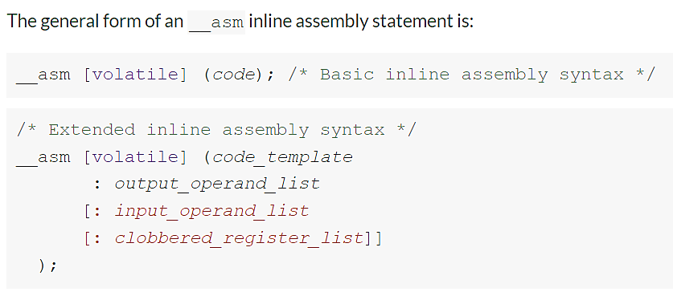
Inline Assembly syntax
Use the volatile qualifier for assembler instructions that have processor side-effects
code is the assembly instruction, for example "ADD R0, R1, R2".
code_template is a template for an assembly instruction, for example "ADD %[result], %[input_i], %[input_j]".
If you specify a code_template rather than code then you must specify the output_operand_list before specifying the optional input_operand_list and clobbered_register_list.
output_operand_list is a list of output operands, separated by commas. Each operand consists of a symbolic name in square brackets, a constraint string, and a C expression in parentheses. In this example, there is a single output operand: [result] "=r" (res). The list can be empty.
For example:
__asm ("ADD R0, %[input_i], %[input_j]" :
/* This is an empty output operand list */
: [input_i] "r" (i), [input_j] "r" (j) );
input_operand_list is an optional list of input operands, separated by commas. Input operands use the same syntax as output operands. In this example, there are two input operands: [input_i] "r" (i), [input_j] "r" (j). The list can be empty.
clobbered_register_list is a comma-separated list of strings. Each string is the name of a register that the assembly code potentially modifies, but for which the final value is not important. To prevent the compiler from using a register for a template string in an inline assembly string, add the register to the clobber list.

Slide 61
Mixed C and Assembly Code
#include <stdio.h>
int add(int i, int j)
{
int res = 0;
__asm ("ADD %[result], %[input_i], %[input_j]"
: [result] "=r" (res)
: [input_i] "r" (i), [input_j] "r" (j)
);
return res;
}
int main(void)
{
int a = 1;
int b = 2;
int c = 0;
c = add(a,b);
printf("Result of %d + %d = %d\n", a, b, c);
}

Slide 62
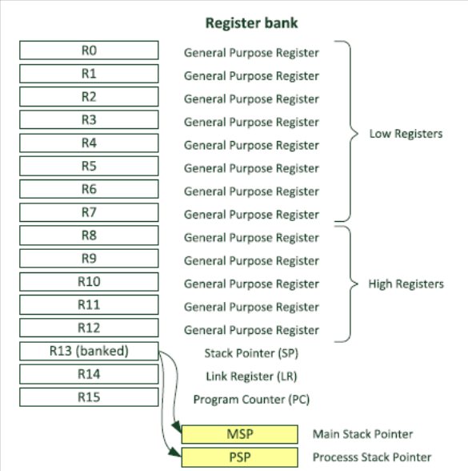
Register Set
R0-R12
  General Purpose registers
  R0-R7 low registers due to limited space available in IS , many 16 bit instruction can only access the low registers.
  R8-R12 high registers can be used by 32-bit instruction
  Initial Value of R0-R12 are undefined.
  R13 Stack Pointer
  R14 Link Register
  R15 Program Counter

Slide 63
Stack Pointer –R13
Physically there are two different Stack Pointers:
Main Stack Pointer is the default Stack Pointer. It is selected after reset, or when the processor is in Handler Mode.
The other Stack Pointer is called the Process Stack Pointer. The PSP can only be used in Thread Mode. The selection of Stack Pointer is determined by a special register called CONTROL.
The PSP is normally used when an embedded OS is involved, where the stack for the OS kernel and application tasks are separated.

Slide 64
Link Register – R14
This is used for holding the return address when calling a function or subroutine or ISR.
At the end of the function or subroutine, the program control can return to the calling program and resume by loading the value of LR into the Program Counter (PC).
When a function or subroutine call is made, the value of LR is updated automatically.
If a function needs to call another function or subroutine, it needs to save the value of LR in the stack first. Otherwise, the current value in LR will be lost when the function call is made.

Slide 65
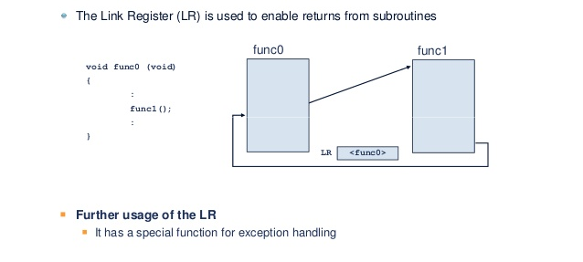
Link Register Flow diagram

Slide 66
Program Counter – R15
It is readable and writeable:
a read returns the current instruction address plus 4 (this is due to the pipeline nature of the design, and compatibility requirement with the ARM7TDMI processor).
Writing to PC (e.g., using data transfer/processing instructions) causes a branch operation.

Slide 67
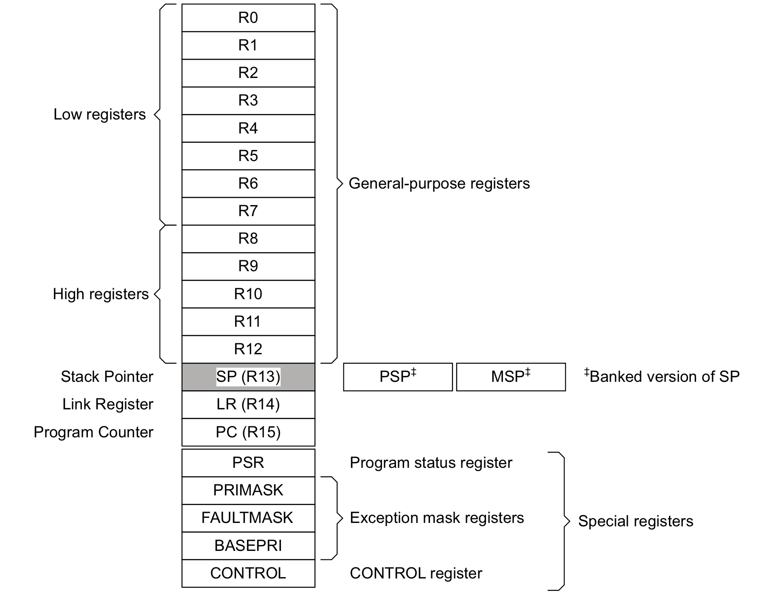
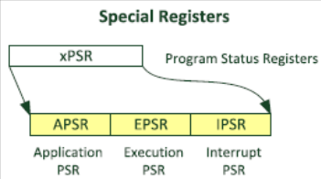
Special Registers
They are needed for development
of an embedded OS, or when advanced interrupt masking features are needed.
Special registers are not memory mapped, and can be accessed using special register
access instructions such as MSR and MRS(Move to ARM register from system coprocessor register).

Slide 68

Program Status Register
31
28 27 26 25 24 23
16 15
10
7
0
N Z C V
Q IT T
IT/ICI
ISR Number
One Status Register consisting of
APSR - Application Program Status Register – ALU flags
IPSR - Interrupt Program Status Register – Interrupt/Exception No.
EPSR - Execution Program Status Register
IT field – If/Then block information
ICI field – Interruptible-Continuable Instruction information
Please note:
• The EPSR cannot be accessed by software code directly using MRS (read as zero) or MSR
• The IPSR is read only and can be read from combined PSR (xPSR).

Slide 69
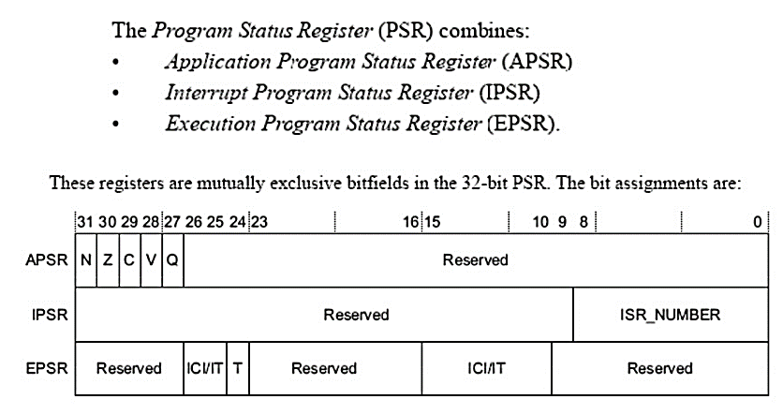
Program Status Register: xPSR

Slide 70
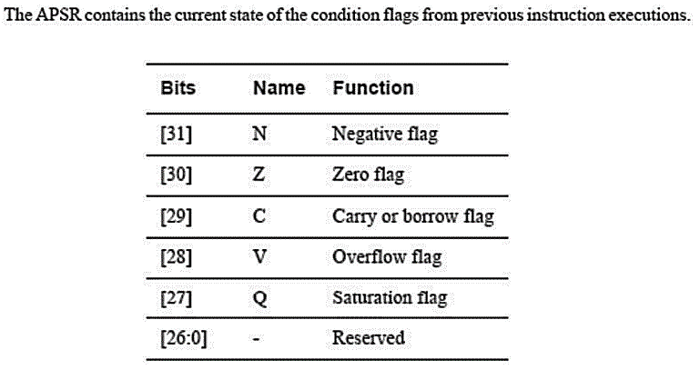
APSR
Bits 28 to 31 are alu condition code flags.
Q bit – sticky overflow flag , used by saturating instructions.
These alu are the only one you can modify in thread mode

Slide 71

Q Flag – Signed & Unsigned Saturation

Slide 72
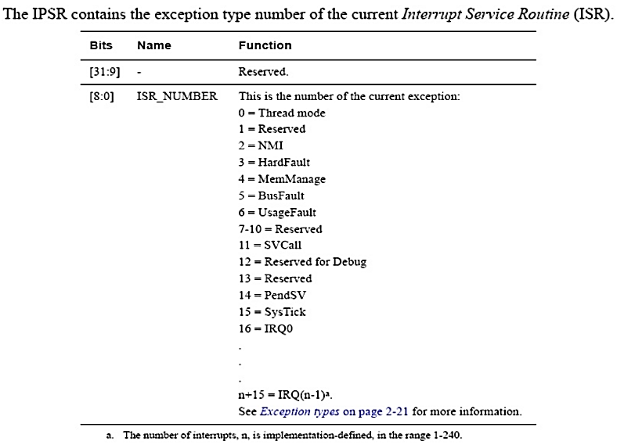
IPSR

Slide 73
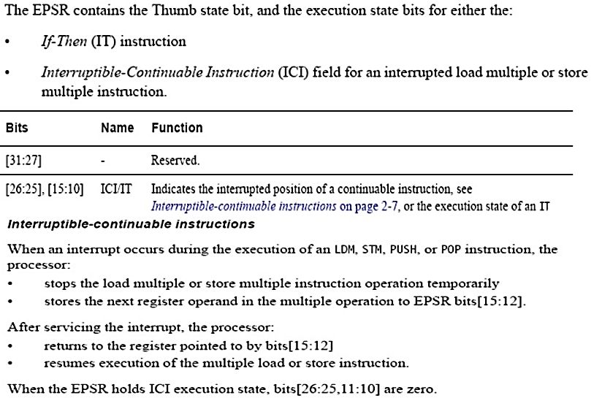
EPSR
*Note: Since Cortex M3 has only thumb2 mode so bit 24 i.e. T bit will always be high and you should never attempt to change it.
The IT (IF-THEN) instruction statement contains the IT instruction opcode with up to an additional
three optional suffixes of “T” (then) and “E” (else), followed by the condition to check against, which is the same as the condition symbol for conditional branches.
The “T”/”E” indicates how many subsequence instructions are inside the IT instruction block, and whether they should or should not be executed if the condition is met.

Slide 74
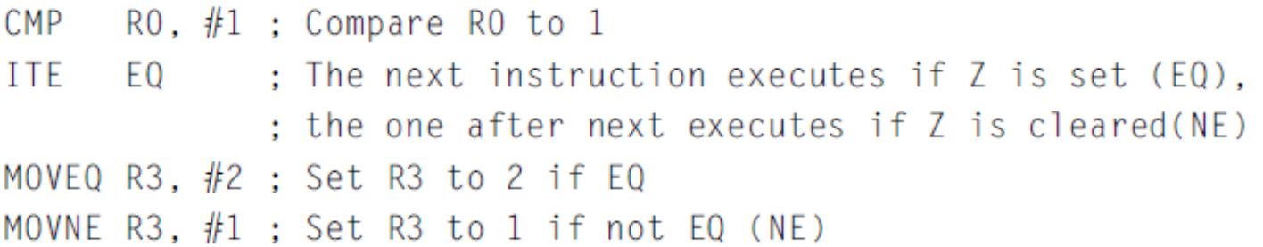
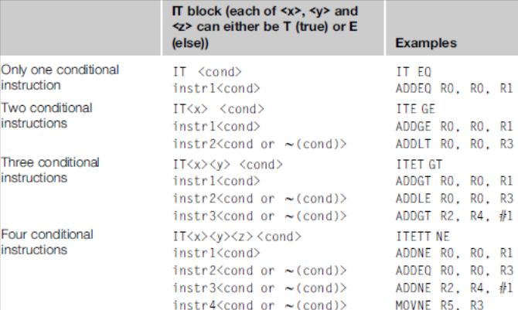
Conditional execution

Slide 75
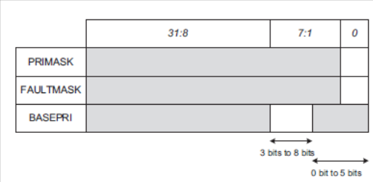
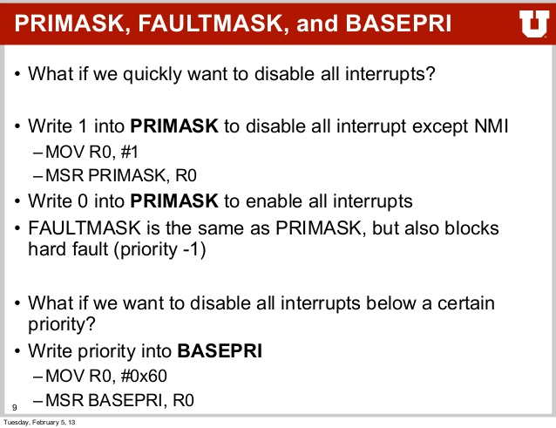
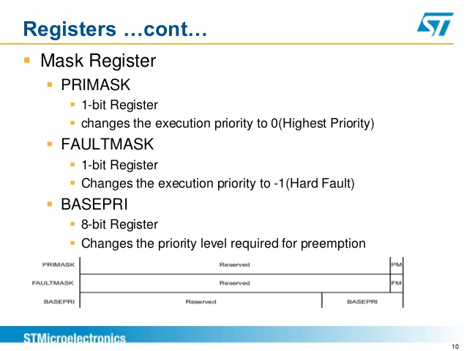
Mask registers

Slide 76
Hard Fault
A hard fault is an exception that occurs because of an error during normal or exception processing. As per the Cortex-M0 Devices Generic User Guide (revision r0p0), the following sources can cause a hard fault:
• execution of an SVC instruction at a priority equal or higher than SVCall
• execution of a BKPT instruction without a debugger attached
• system-generated bus error on a load or store
• system-generated bus error on a vector fetch
• execution of an instruction from a location for which the system generates a bus fault
• execution of an instruction when not in Thumb-State as a result of the T-bit being previously cleared to 0
• execution of an undefined instruction
• attempted load or store to an unaligned address
• execution of an instruction from an XN memory address
The most common user-created causes for hard fault are:
• execution of an undefined instruction
• attempted load or store to an unaligned address.
• execution of an instruction from an XN memory address
Detecting the hard fault
When your system is hung up, the first step is to detect the cause for the hang up. To detect the cause for system hang up, first execute your program in debugging mode and allow the system to run until the system hangs up again, then halt the debugger. There are two ways to determine whether the hang up is due to the hard fault. The first is to watch the Program Counter (PC) register. If this is a hard fault, the PC register will indicate operation in the hard fault handler. The second method is to watch the Interrupt Program Status Register (IPSR).
Exception Number 3 indicates a hard fault.

Slide 77
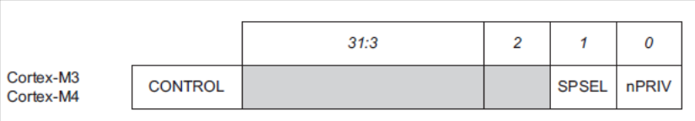
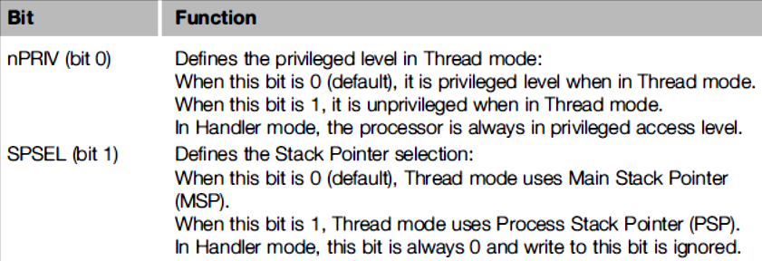
CONTROL register
The CONTROL register controls the stack used and the privilege level for software execution when the processor is in Thread mode.

Slide 78
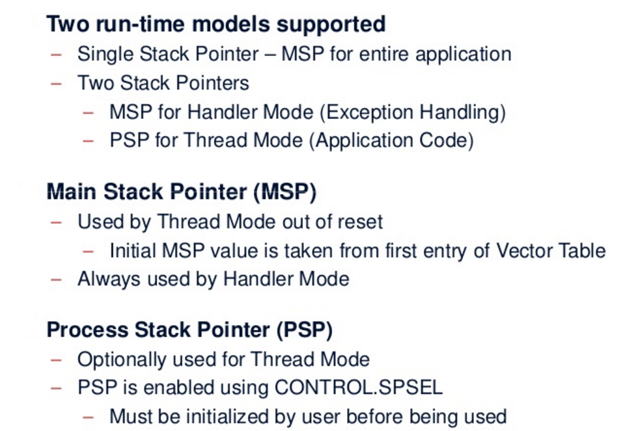
Stacks

Slide 79
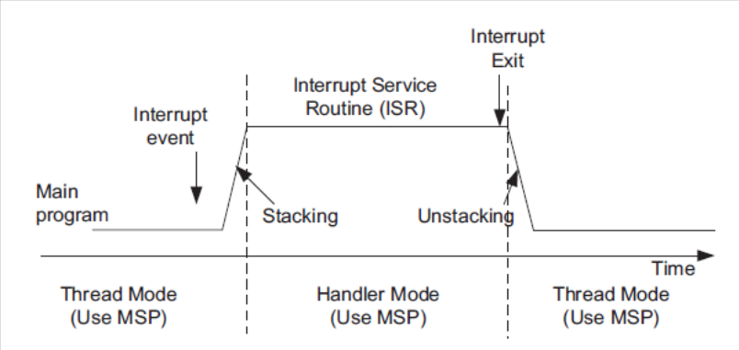
Both Thread and Handler using MSP

Slide 80
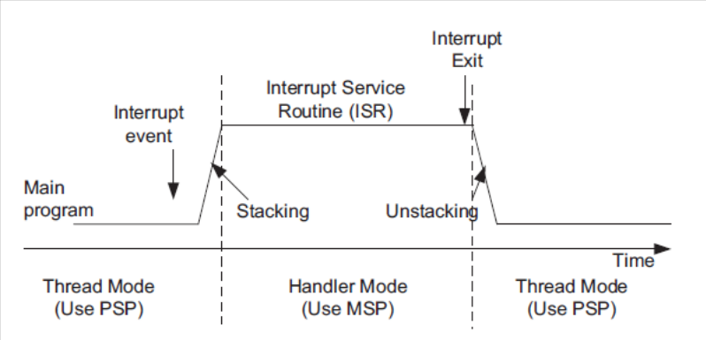
Thread uses PSP & Handler uses MSP

Slide 81

Stack Pointer selection

Slide 82

Switching Privileged & Unprivileged

Slide 83

Processor Modes in v7-M

Slide 84

Privilege, Modes and Stacks

Slide 85
Memory System
Memory System features
  4GB linear address space
  Architecturally defined memory map
  Support for little endian and big endian memory systems
  Bit band accesses (optional)
  Write buffer - When a write transfer to a buffered memory region will take multiple cycles, the transfer can be buffered by the internal write buffer in the Cortex-M3 or Cortex-M4 processor so that the processor can continue to execute the next instruction, if possible. This allows higher program execution speed.
  Memory Protection Unit (Optional)
  Unaligned transfer support

Slide 86

Memory Map

Slide 87

Stack Memory

Slide 88
Exceptions and Interrupts
What are exceptions?
  Exceptions are events that cause changes to program flow. When one happens, the processor suspends the current executing task and executes a part of the program called the exception handler.
  After the execution of the exception handler is completed, the processor then resumes normal program execution.
  In the ARM architecture, interrupts are one type of exception. Interrupts are usually generated from peripheral or external inputs, and in some cases they can be triggered by software.
  The exception handlers for interrupts are also referred to as Interrupt Service Routines (ISR).
  Link

Slide 89

Various Exception sources

Slide 90

Exception Types

Slide 91
Nested Vectored Interrupt Controller
Features
  Flexible exception and interrupt management
    Each interrupt (apart from the NMI) can be enabled or disabled and can have its pending status set or cleared by software.
  Nested exception/interrupt support
    Each exception has a priority level. Some exceptions, such as interrupts, have programmable priority levels and some others (e.g., NMI) have a fixed priority level. When an exception occurs, the NVIC will compare the priority level of this exception to the current level. If the new exception has a higher priority, the current running task will be suspended.
  Vectored exception/interrupt entry
    The Cortex-M processors automatically locate the starting point of the exception handler from a vector table in the memory. As a result, the delays from the start of the exception to the execution of the exception handlers are reduced.
  Interrupt masking

Slide 92
Starting Address of Exception Handler
To determine the starting address of the exception handler, a vector table mechanism is used.
The vector table is an array of word data inside the system memory, each representing the starting address of one exception type.
Example :The vector table is located at address 0x0 after reset.
if the reset is exception type 1, the address of the reset vector is 1 times 4 (each word is 4 bytes), which equals 0x00000004, and the NMI vector (type 2) is located at (n x 4)2 x 4 = 0x00000008 .
The address 0x00000000 is used to store the starting value of the MSP.
The LSB of each exception vector indicates whether the exception is to be executed in the Thumb state. Since the Cortex-M processors can support only Thumb instructions, the LSB of all the exception vectors should be set to 1.

Slide 93

Vector Table
LSB of exception vectors should be set to 1 to indicate Thumb state

Slide 94

Fault Handling

Slide 95
System Control Block (SCB)
One part of the processor that is merged into the NVIC unit is the SCB. The SCB contains various registers for:
  Controlling processor configurations (e.g., low power modes)
  Providing fault status information (fault status registers)
  Vector table relocation (VTOR)
The SCB is memory-mapped. Similar to the NVIC registers, the SCB registers are accessible from the System Control Space (SCS).

Slide 96

Core Sight Debug and Trace Technology

Slide 97
Core Sight features
Core Sight features can be accessed through a JTAG or Serial Wire interface. Debugging in JTAG and Serial Wire mode at the same time is not possible. Cortex-M processor-based devices can include a:
Debug Interface
The debug interface offers two modes:
JTAG Debug is the industry-standard interface that allows device chaining.
Serial Wire Debug is a 2-pin interface with an optional Serial Wire Trace Output. In contrast to JTAG, devices cannot be chained.
The Debug Interface communicates with the following units:
Run Control: allows the user to start, stop, and single-step through the source code.
Breakpoint Unit: allows the user to set breakpoints even while the processor is running.
Memory Access Unit: allows the user to read or write to memory and peripheral registers even while the program is running.

Slide 98

Debug connections

Slide 99
Trace Port Interface Link
The Trace Port Interface encodes and provides trace information via two possible interfaces:
The Serial Wire Trace Output pin (SWO) can be used in Serial Wire Debug mode only.
The 4-Pin Trace Output has a greater bandwidth than Serial Wire Trace Output and uses 5 functional pins. It is the only way to output ETM trace data. However, the ULINKpro USB-JTAG/SW debugger adapter is required to use this feature.
The Trace Port Interface communicates with the following units:
Embedded Trace Macrocell (ETM): can be used for instruction tracing to debug historical sequences, for software profiling, and code coverage analysis. ETM data are output through an extra 4-bit interface (ULINKpro required).
Instrumentation Trace Macrocell (ITM): provides application information like debug printf(), RTOS information, unit test, or UML annotation.
Data Watchpoint & Trace Unit (DWT): provides PC sampling, event counters, timing, and interrupt execution information. In addition, it allows Access Breakpoints for up to four memory addresses.
Serial Wire-JTAG Switch (SWJ)
This switch is used to synchronize the debugger adapter and the CoreSight debug interface. ULINK2 uses this option to generate sequences for switching between Serial Wire Debug and JTAG Debug mode.

Slide 100

Trace Connections

Slide 101

Cortex Reset Sequence & Startup
Link

Slide 102

Vector Table at Startup

Slide 103

Reset Sequence

Slide 104

Reset Behavior

Slide 105

Status of SP and PC during reset

Slide 106

Task to be Performed

Slide 107

Initialization Summary

Slide 108
Memory System
CDAC ACTS, Pune

Slide 109
Agenda
Memory Map
Connecting the processor to memory and peripheral
Memory Requirements
Memory Endianness
Data alignment and Unaligned data access
Bit-band operations
Default Memory Access permissions
Exclusive access
Memory Barrier
Memory System in a microcontroller

Slide 110
Memory Map

Slide 111


Slide 112

Multiple Bus Interfaces for different memory regions

Slide 113


Memory Endianness
The Cortex-M3 (byte-invariant big-endian, BE-8) – Data on
the AHB Bus
Little Endian – Data on the AHB Bus

Slide 114

Data alignment and unaligned data access

Slide 115
Bit Banding
Normally Bit Manipulation requires a READ MODIFY WRITE operations which is expensive in terms of no. of CPU cycles taken.
To overcome this limitation , a technique called bit banding allows direct bit manipulations on section of Peripheral and SRAM memory , without need of special instructions.
While performing Bit banding operations we need to consider two memory regions
  Bit Band Region [1 MB]
  Bit Band Alias Region [32 MB]
Bit Banding works by mapping each Bit in the Bit Band Region to a Word in Alias Region

Slide 116

Bit Access to Bit band region

Slide 117

Bit Banding Mapping

Slide 118
Cortex-M3 Bit Banding
Calculate the bit band alias address for given bit band memory address and bit position.
5th bit position of the memory location 0x20000200 using its alias address
Formula:
Alias_address=alias_base+ (32*(bitband_memory_addr – bitband_base_address))+ bit*4

Slide 119



Read Modify Write vs Bit Banding
Assembler sequence to write a bit with and without bit-band
Read from the bit-band alias

Slide 120

Cortex-M3 Bit Banding
Writes to a word address in the bit band alias affect a single bit in the bit band region
The write is translated to an atomic read-modify-write by the Cortex-M3 bus matrix
Bit 0 of the stored register is written to the appropriate bit
Word alias
32MB
Bit band alias
32MB
31MB
Physical bit
1MB
Bit band region
32MB
Bit band alias
31MB
1MB
Bit band region

Slide 121
Advantages of Bit-Band
Bit-Band vs. Bit-Bang
  In the Cortex-M3, we use the term bit-band to indicate that the feature is a special memory band (region) that provides bit accesses.
  Bit-bang commonly refers to driving I/O pins under software control to provide serial communication functions. The bit-band feature in the Cortex-M3 can be used for bit-banging implementations, but the definitions of these two terms are different.
Reading the whole register ,Masking the unwanted bits,Comparing and branching
You can simplify the operations by BitBanding to:
Reading the status bit via the bit-band alias (get 0 or 1) ,Comparing and branching

Slide 122
Memory Access attributes
Bufferable: Write to memory can be carried out by a write buffer while the processor continues on to next instruction execution.
Cacheable: Data obtained from memory read can be copied to a memory cache so that next time it is accessed the value can be obtained from the cache to speed up program execution.
Executable: The processor can fetch and execute program code from this memory region.
Sharable: Data in this memory region could be shared by multiple bus masters. The memory system needs to ensure coherency of data between different bus masters in the shareable memory region.

Slide 123

Memory Types and Properties

Slide 124

Memory Attributes in Relation to Memory Types

Slide 125


Multi-Processor System Sharable Memory
Buffered write operation

Slide 126

Address Map Overview

Slide 127

Exclusive Access via MUTEX semaphore

Slide 128
Memory system in a Microcontroller
In many microcontroller devices, the designs integrate additional memory system features such as:
Boot loader
Memory remapping
Memory alias
There are many different reasons why chip designers put a boot loader into the system. For example, to:
Provide a flash programming utility, so that you can program the flash using a simple UART interface, or even program some parts of the flash memory dynamically.
Provide Built-In Self Test (BIST) for the chip.

Slide 129
Bootloaders and Memory Remapping
For chips with a boot loader ROM, the boot loader is executed when the system is started, so it has to be located in address 0 when the system starts at power up.
However, the next time the system starts, it might not need to execute the boot loader again and can run the application in the flash directly, so the memory map needs to be changed.
In order to do this, the address decoder needs to be programmable. A hardware register (e.g., a peripheral register in a system control unit) can be used.
The operation to switch the memory map is called “Memory Remap.” This operation is done by the boot loader.

Slide 130


Slide 131

Memory remap implementation with boot loader

Slide 132
Possibilities of Re-mapping
Normally the boot loader is accessible from address 0 using a memory address alias, and the alias can be turned off. There are many possible memory system configurations. What is shown in prev. slide is just one of the possibilities.
Other Possibilities Video Link1, Link2
In some microcontrollers, memory remapping is not needed as the boot loaders present in address 0 are executed every time the system starts up.
The vector table is then relocated using the vector table relocation feature provided by the processor, so there is no need to use any remap to handle vector fetches.

Slide 133

Flash Memory Starting Address after Reset
All ARM Cortex M Based MCUs right after reset does,
Load value @ Memory addr. 0x00000000 in to MSP
Load value @ Memory addr. 0x00000004 in to PC (Value = Addr of the reset handler)
In STM32 Microcontroller ,
MSP value stored at 0x08000000
Vector table starts from 0x08000004
Address of the reset handler found at 0x08000004
So , Don’t you think we should somehow link 0x08000000 to 0x00000000 ??

Slide 134
Exceptions and Interrupts
CDAC ACTS, Pune

Slide 135
Agenda
Exception types
Overview of interrupt management
Definitions of priority
Vector table and vector table relocation
Interrupt inputs and pending behaviors
Details of NVIC registers for interrupt control
Summary
Interrupt enable registers
Interrupt set pending and clear pending
Active status
Priority level
Software trigger interrupt register
Interrupt controller type register

Slide 136
Agenda
Details of SCB registers for exception and interrupt
control
Summary of the SCB registers
Interrupt control and state register (ICSR)
Vector table offset register (VTOR)
Application interrupt and reset control register
System handler priority registers
System handler control and state register

Slide 137
Exception Type

Slide 138

Exception types

Slide 139


Slide 140

List of Interrupts

Slide 141

CMSIS-Core Exception Definitions

Slide 142

Commonly Used CMSIS-Core Fxns

Slide 143


Definition of Priority
A priority-level register with 3 bits implemented (8 programmable priority levels)
A priority-level register with 4 bits implemented (16 programmable priority levels)

Slide 144


Slide 145
Group Priority
if the priority-level configuration registers are 8-bits wide, there are only 128 pre-emption levels?
This is because the 8-bit register is further divided into two parts: group priority and sub-priority.
Using a configuration register in the System Control Block (SCB) called Priority Group
the priority-level configuration registers for each exception with programmable priority levels is divided into two halves.
The group priority level defines whether an interrupt can take place when the processor is already running another interrupt handler.
The sub-priority level is used only when two exceptions with same group-priority level occur at the same time.

Slide 146

Group Priority

Slide 147
Vector Table and its Relocation
When the Cortex-M processor accepts an exception request, the processor needs to determine the starting address of the exception handler (or ISR if the exception is an interrupt).
This information is stored in the vector table in the memory. By default, the vector table starts at memory address 0.
The vector table is normally defined in the startup codes provided by the microcontroller vendors.
Usually, the starting address (0x00000000) should be boot memory, and it will usually be either flash memory or ROM devices.
The Vector Table Relocation feature provides a programmable register called the Vector Table Offset Register (VTOR)

Slide 148

Vector Table Offset Register

Slide 149

Vector Table Relocation for Boot Rom

Slide 150

Booting from Pen Drive or SD Card

Slide 151
Interrupt Inputs and Pending Behavior
There are various status attributes applicable to each interrupt:
• Each interrupt can either be disabled (default) or enabled
• Each interrupt can either be pending (a request is waiting to be served) or not pending
• Each interrupt can either be in an active (being served) or inactive state
An interrupt request can be accepted
by the processor if:
• The pending status is set,
• The interrupt is enabled, and
• The priority of the interrupt is higher than the current level

Slide 152

Interrupt pending and activation behavior

Slide 153

Register In NVIC for Interrupt Control

Slide 154
Exceptions Handling In Detail
CDAC ACTS, Pune

Slide 155
Agenda
Exception sequences
Exception Entrance and stacking
Exception return and unstacking
Interrupt latency and exception handling optimization
Details of NVIC registers for interrupt control
What is interrupt latency?
Tail Chaining
Late arrival
Pop preemption
Lazy stacking

Slide 156

Exception entrance and stacking

Slide 157

Nested Interrupt Stacking

Slide 158
Interrupt Handling
▪
▪
One Non-Maskable Interrupt (INTNMI) supported 1-240 prioritizable interrupts supported
▪
▪
Interrupts can be masked
Implementation option selects number of interrupts supported
▪
▪
Nested Vectored Interrupt Controller (NVIC) is tightly coupled with processor core Interrupt inputs are active HIGH
INTNMI
1-240 Interrupts INTISR[239:0]
NVIC
Cortex-M3 Processor Core
…
Cortex-M3

Slide 159

Feature Description of NVIC

Slide 160

Working of NVIC

Slide 161

NVIC Operations Exception Entry/Exit

Slide 162

Interrupt Preemption

Slide 163

Tail Chaining

Slide 164

Pop Preemption

Slide 165

Late Arrival

Slide 166
Exception for System Level Services
ARM Cortex M Processor Supports two important system level exceptions
  SVC (SuperVisor Call)
  PendSV (Pendable SerVice)
Supervisory calls are typically used to request privilege operations or access to system resource from an Operating System
SVC Exception is mainly used in OS environment. For E.g. an Unprivileged user task can trigger SVC exception to get system level services(e.g. accessing device drivers, peripherals) from kernel of OS
PendSV is mainly used in an OS environment to carry out context Switching Operation between two tasks when no other exceptions are active in the system.

Slide 167
Low Power and System Control Features
CDAC ACTS, Pune

Slide 168
Power Management
▪
Multiple sleep modes supported
Controlled by NVIC
Sleep Now – Wait for Interrupt/Event instructions
Sleep On Exit – Sleep immediately on return from last ISR
Deep Sleep
  Long duration sleep, so PLL can be stopped
  Exports additional output signal SLEEPDEEP
▪
Cortex-M3 system is clock gated in all sleep modes
Sleep signal is exported allowing external system to be clock gated also
NVIC interrupt Interface stays awake
▪
Wake-Up Interrupt Controller (WIC)
External wake-up detector allows Cortex-M3 to be fully powered down
Effective with State-Retention / Power Gating (SRPG) methodology

Slide 169

Clock Gating
Clock gating is a popular technique used in many synchronous circuits for reducing dynamic power dissipation.
Clock gating saves power by adding more logic to a circuit to prune the clock tree.
Pruning the clock disables portions of the circuitry so that the flip-flops in them do not have to switch states because Switching states consumes power.
When not being switched, the switching power consumption goes to zero, and only leakage currents are incurred.

Slide 170


Activities in an Interrupt-Driven Application

Slide 171


Various Power Modes

Slide 172

Entering Low Power Modes

Slide 173

Wakeup Interrupt Controller

Slide 174
WIC
The interrupt detection logic of the WIC can be customized by silicon designers to support asynchronous operation.
This means that the WIC can operate without any clock signal.
When an interrupt request arrives, the WIC detects the request and informs the PMU to restore the clock,
Then the processor can wake up, resume operations, and service the interrupt request.

Slide 175

WIC Entry

Slide 176
State Retention Power Gating
In some designs, advanced power-saving techniques called State Retention Power Gating (SRPG) can be used to reduce the leakage current of the chip by a wide margin.
In SRPG designs, the registers (often called flip-flops in IC design terminology) have a separate power supply for state retention elements inside the registers .
When the system is in Deep Sleep mode, the normal power supply can be turned off, leaving only the power to the state retention elements on.
The leakage in this type of design is greatly reduced because the combinatorial logic, clock buffers, and most parts of the registers are powered down.

Slide 177

SRPG

Slide 178


System Timer (SysTick)

Slide 179

Cortex System Timer

Slide 180



Cortex-M3 Pipeline
Cortex-M3 has 3-stage fetch-decode-execute pipeline
  Similar to ARM7
  Cortex-M3 does more in each stage to increase overall performance
1st Stage - Fetch
2nd Stage - Decode
3rd Stage - Execute
AGU
Address Phase & Write Back
Data Phase Load/Store & Branch
Fetch (Prefetch)
Instruction Decode & Register Read
Multiply & Divide
Write
Branch forwarding & speculation
Branch
Shift
ALU & Branch
Execute stage branch (ALU branch & Load Store Branch)

Slide 181
The Cortex microcontroller software interface standard (CMSIS)
• CMSIS was developed by ARM to allow microcontroller and software vendors to use a consistent software infrastructure to develop software solutions for Cortex-M microcontrollers.
• Many software products for Cortex-M microcontrollers are CMSIS-compliant.
Currently the Cortex-M microcontroller market comprises:
• More than 15 microcontroller vendors shipping Cortex-M microcontroller
products, with some other silicon vendors providing Cortex-M based
FPGA and ASICs
• More than 10 toolchain vendors
• More than 30 embedded operating systems
• Additional Cortex-M middleware software providers for codecs, communication
protocol stacks, etc.
With such a large ecosystem, some form of standardization of the way the software
infrastructure works becomes necessary to ensure software compatibility with
various development tools and between different software solutions.

Slide 182
CMSIS
To Increase the interoperability of various software components , ARM worked with various microcontroller vendors, tools vendors, and software solution providers to develop CMSIS, a software framework covering most Cortex-M processors and Cortex-M microcontroller products.
The aims of CMSIS include:
• Enhanced software reusability - makes it easier to reuse software code in
different Cortex-M projects, reducing time to market and verification efforts.
• Enhanced software compatibility - by having a consistent software infrastructure
(e.g., API for processor core access functions, system initialization method,
common style for defining peripherals), software from various sources can work
together, reducing the risk in integration.
• Easy to learn - the CMSIS allows easy access to processor core features
from the C language. In addition, once you learn to use one Cortex-M
microcontroller product, starting to use another Cortex-M product is much easier
because of the consistency in software setup.
• Toolchain independent - CMSIS-compliant device drivers can be used with
various compilation tools, providing much greater freedom.
• Openness - the source code for CMSIS core files can be downloaded and
accessed by everyone, and everyone can develop software products with CMSIS.

Slide 183
CMSIS Projects
• CMSIS-Core (Cortex-M processor support)
• CMSIS-DSP library
• CMSIS-SVD - the CMSIS System View Description
• CMSIS-RTOS - the CMSIS-RTOS is an API specification for embedded OS
• CMSIS-DAP - the CMSIS-DAP (Debug Access Port)

Slide 184
Standardization in CMSIS-Core
Standardized access functions to access processor’s features - These include various functions for interrupt control using NVIC, and functions for accessing special registers in the processors.
Standardized functions for system initialization - Most modern feature-rich microcontroller products require some configuration of clock circuitry and power management registers before the application starts. In CMSIS-compliant
device-driver libraries, these configuration steps are placed in a function called “SystemInit().” However, having a standardized function name and a standardized location where this function can be found makes it much easier for a designer to pick up and start using a new Cortex-M microcontroller device.
Standardized software variables for clock speed information - This might not be obvious, but often our application code does need to know what clock frequency the system is running at. For example, such information might be needed for setting up the baud rate divider in a UART, or to initialize the SysTick timer for an embedded OS. A software variable called “SystemCoreClock” is defined in the CMSIS-Core.

Slide 185
Organization of CMSIS-Core
In a general sense, we can define the CMSIS into multiple layers:
• Core Peripheral Access Layer - Name definitions, address definitions, and helper functions to access core registers and core peripherals. This is processor specific and is provided by ARM.
• Device Peripheral Access Layer - Name definitions, address definitions of peripheral registers, as well as system implementations including interrupt assignments, exception vector definitions, etc. This is device specific (note: multiple devices from the same vendor might use the same file set).
• Access Functions for Peripherals - The driver code for peripheral accesses. This is vendor specific and is optional. You can choose to develop your application using the peripheral driver code provided by the microcontroller vendor, or you can program the peripherals directly if you prefer.
There is also a proposed additional layer for peripheral accesses:
Middleware Access Layer - This layer does not exist in current version of CMSIS. The idea is to develop a set of APIs for interfacing common peripherals such as UART, SPI, and Ethernet. If this layer exists, developers of middleware can develop their applications based on this layer to allow software to be ported between devices easily.

Slide 186

CMSIS-Core structure

Slide 187

Using CMSIS in Project

Slide 188


Enabling key IoT technologies in mbed!
Internet
Notes:
Make billions of IoT devices a reality (and ARM based…)
the right ecosystem and tools
an army of developers
Engage with customers
User programmable devices: mbed tools
mbed tools for MCU, user programmable radio, smart sensors
Enable a huge user audience to get to volume faster, low-cost boards, analytics
Instant integration of user projects to cloud service and IoT technologies
Enables a solution sell with other components
NXP, Atmel, Cypress, SiLabs, Gainspan targets
How to engage on mbed tools
New, more accessible business model
licensing structure summary
First steps on engagement (collateral, howto)
‘Dumb’ sensor and radio: mbed project
Contribute component to database (very low barrier)
Their users have instant access to ARM mbed community
Primed for licensing ARM Cortex-M processors when the need arises
Maxim, Linear, SiLabs, Analog Devices, Invensense, Vital Connect, Intersil, IDT
ARM licensee radio & sensor groups : mbed project (perhaps hide this slide? we can address doug and Kristen directly on this)
No user programmable ARM processor today
Engage these groups as mbed contributors
Enables them to solution sell of components with MCU
Solve internal communication / software support issues
TI Wireless, Freescale Sensor targets
How to engage on mbed project
This is what the component database looks like
Technical details are on this /blog
Email mbed-contributors@mbed.org to engage
mbed summary
Summary
Your account can add to the open source component database today
New business model on tools
An ecosystem catalyst for IoT
Team picture

Slide 189


41

Slide 190
Project Discussion-1
Node 1: STM32F4 Discovery
Cortex M
Driver Implementation
(CAN Driver)
Option Use of FreeRTOS
Data Acquisition System
Sensor Data Collection
Ultrasonic, DHT, 3D Acc
Node 2: BeagleBone Black / STMF4
Cortex A
Socket CAN Implementation
using Python
Information System
Display in I2C Based OLED
Send Data to Cloud (Adafruit,
Think Speak, AWS)
CAN Bus
Microcontroller/IoT Based/RTOS as Middleware
Deep Drive in RTOS: Task Modelling, Designing Time Triggered Arch.
Linux Device Drivers
Networking Based
UART Bus
ESP32 for Cloud

